Slide 1
Service mesh

Slide 2
Agenda
Understand the challenges of service mesh
What is service mesh
Understand the architecture of service mesh

Slide 3
Microservice challenges
Business logic
Security
Retry logic
Metrics
tracing

Slide 4
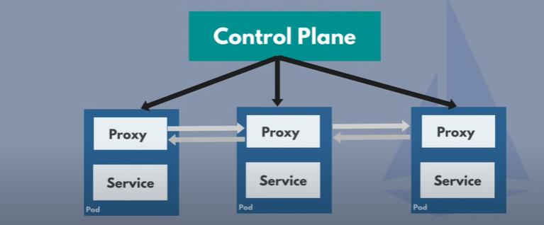
Service mesh with sidecar pattern
Handles network logic
Acts as proxy

Slide 5
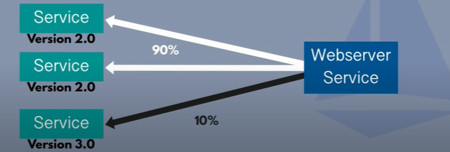
During new release (Traffic splitting): Canary

Slide 6
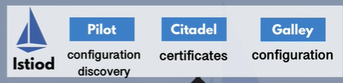
Istio Architecture
Istio is one of implementation of service mesh
Istio divide in two parts
Control plane :istiod (configuration, discovery, certificates) - All components integrated in istiod
Data plane: Envoy proxy
Istio can be configured using Kubernetes yaml file
Istio uses Kubernetes CustomResourceDefinitions (CRDs)
Extending k8s api
Provide extended api to configure third party technology in existing Kubernetes clusters
Using these crds ,can configure traffic routing rules,retry rules, communication

Slide 7
CRD’s for istios
Two main CRD’s:
VirtualService
How to route traffic to given destination
DestinationRule
Configure what happens to traffic for the destination
Istiod will read these CRD’s ,converts these into envoy specific configuration
Configuration is propagated into proxy sidecar
What does that mean?? We just configure control plane, control plane push that into proxy sidecars
Now Proxy communicate each other, once they receive the logic from control plane

Slide 8
Istio ingress gateway
Istio gateway is ingress controller
It is alternative on nginx controller
In kind, we can specifiy “gateway” for istio gatewy
Istio gateway acts as LB, as it receive the incoming traffic
Using virtualserive, it will route the traffic to the microservice

Slide 9
Istio Traffic flow
All incoming traffic will hit the istio gateway
Istio gateway will go through the virtualService, and virtual service will send to envoy proxy.
Based on the destination rule and virtualService info, envoy will route traffic to Microservice
During the traffic flow, proxy will collect all the metrics data and send to control plane (istiod)

